Slide 1
Revisiting what I hope was learned this semester, toward Comps The foundational 3 Liberal Arts: Grammar, Logic, Rhetoric
Brian Mapes
ATM 651, Fall 2023

Slide 2
Part I: Grammar (fundamentals)
math notation: revisit HW1!
functions like T(x,y,z,t)
partial derivatives
derivative operator concept (del is the vector form)
vectors: sum and dot and cross
physics principles and laws
conservation of stuff, plus sources minus sinks
transport (advection or convergence of flux)
by large scale motions
by small: diffusion (convergence of a downgradient flux)
words for it all: review exam solutions

Slide 3
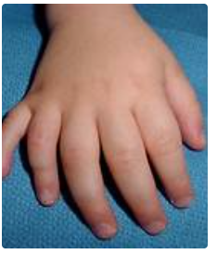
Physical units: made for our science!
MKS (or SI) system: Earth, Water, Fingers (10)
except for time
m = (Pole-Eq distance)/10⁷
kg = (mass of 1m³ water)/10³
K = (T_{boil} - T_{freeze})/100
s = (rotation time of Earth)/24/60/60
Some long-lost 6-fingered people? “angle” (360º)
so time’s circular nature fell into their grasp
(maybe because 12 mo/y)?
“The condition has an incidence of 1 in every 500 live births.”

Slide 4
Calculus of multi-dimensional fields
T(x,y,z,t), etc.
the 4 partial derivatives are obvious:

Slide 5
Calculus of fields in space-time → special d/dt or D/Dt derivative (“Lagrangian”)
time is special as a coordinate: dt/dt = 1 s/s
moving frame of reference x_{r}(t only), y_{r}(t), z_{r}(t)
Chain rule:
dT/dt = ∂T/∂t + ∂T/∂x (dx_{r}/dt) + …
If reference frame follows fluid motion, dx_{r}/dt = u (m/s)
→ dT/dt = ∂T/∂t + ∂T/∂x (u) + ∂T/∂y (v) + …
but reference frame is also used for WH problem involving time series measured by a moving ship

Slide 6
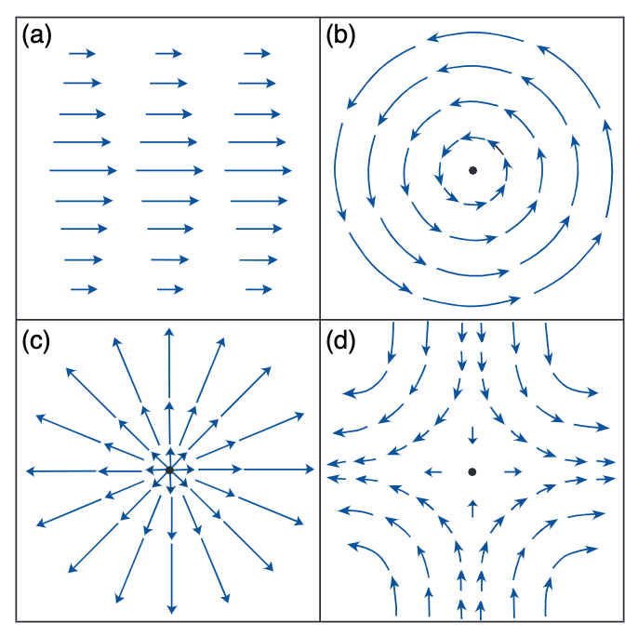
Calculus of fields in space-time
vectors are objects with direction, magnitude
Kinematics in 2D
vorticity
divergence
deformation
shear = 1 + 3
vor = shear + curvature

Slide 7
Vectors
vectors are objects with direction, magnitude
addition is straightforward (like walking)
multiplication = product of magnitudes,
times
cosine of angle between them (projection or shadow) for the scalar or inner or dot product
sine of angle unit vector, times unit vector orthogonal to both, for cross product (in 3D only)

Slide 8
(factor) operator(operand)
Operators do not commute! Be careful
Example: derivative (of ANYTHING) ∂/∂t
consider 7 ∂/∂t()
7 to left is multiplied
anything to right is operated on
∂/∂t(7) = 0 of course!
Nabla behaves like that

Slide 9
V dot del: a useful combination of vector and operator notation. Advective tendency is –V dot del(stuff)
Or if we use p as a vertical coordinate,

Slide 10
del dot V: the divergence of V
on a constant pressure surface, in this case
Convergence is negative divergence

Slide 11
Ready to use Laws of Physics!
d/dt(T) = (diabatic heating)-(adiabatic cooling)
d/dt(V) = a = (sum of all Forces per unit mass)
ρ = p/RT equation of state (density = …)
Mass is conserved: humble, but key to fluids
Div(mass flux) = div (ρV) = ∂/∂t(ρ) = 0 for soundproof equation sets (infinite speed of sound assumption)
total mass is conserved
dry air mass is conserved
total water mass of all phases “ “
it becomes an equation for pressure (the Cop)

Slide 12
OK, we assembled the ”governing” partial differential equations (PDEs)
All possible weathers are solutions to these
What would it mean to understand or grasp something more? (“dynamics” of behaviors)
Before computers, we had only mathematical manipulations, illustrative of concepts, in various tractable special cases

Slide 13
Dynamics as interpretation of budgets
∂/∂t(stuff) = transport + source - sink
Terms on the right may be interpreted as
forcing
damping (negative feedback)
amplification (positive feedback)
That interpretation is a dynamical theory
more than the budget (which is simply flatly true)

Slide 14
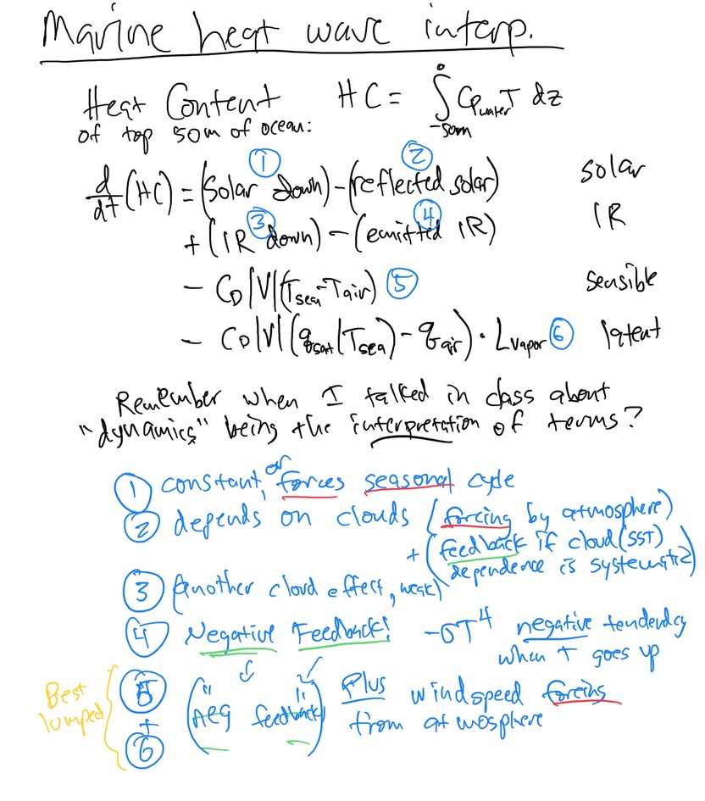
Dynamics as interpretation of budgets
Forcing, damping, feedbacks
Example: heat budget of upper ocean HC

Slide 15
What can we do with the PDEs I
1. Seek leading-order balances
discard or ignore small-valued terms
based on scale analysis of term size
for example, geostrophy
Coriolis force (scale ~ f*U) balances PGF
Mom. advection -u ∂u/∂x scale ~ U*U/L
a.k.a. “inertial forces”
Ratio Adv/Cor is called Rossby number
Ro = U/fL, small for geostrophic flows
Local rate of time change is U/T
ratio (fU) / (U/T) = Tf is small in geostrophy

Slide 16
What PDE terms to throw out?
frictional forces (too complicated)
➔ inviscid
thermodynamic heatings (too complicated)
➔ adiabatic
time derivatives (negligible for slow changes)
➔ balance, equilibrium, steady-state, time-mean
example: hydrostatic balance (dw/dt <<< g and VPGF)
allows us to use p_{hyd} as a “mass coordinate” in the vertical
greatly simplifies mass continuity

Slide 17
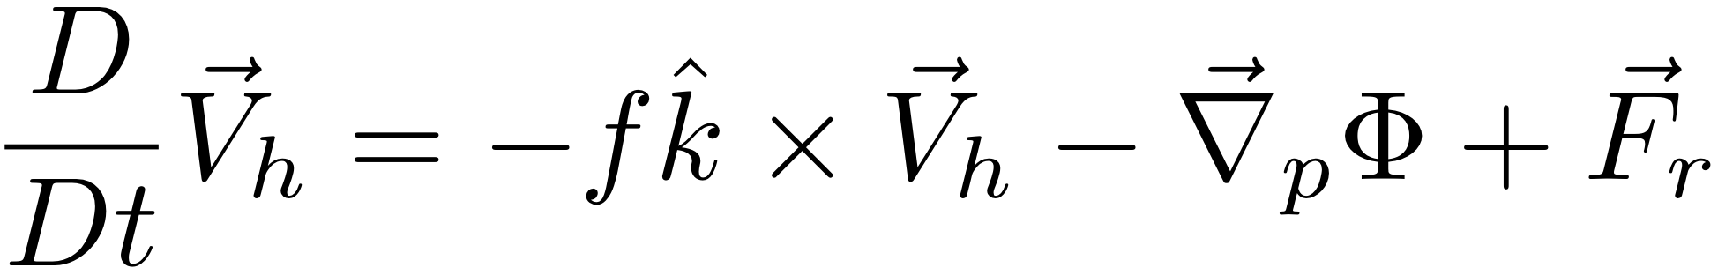
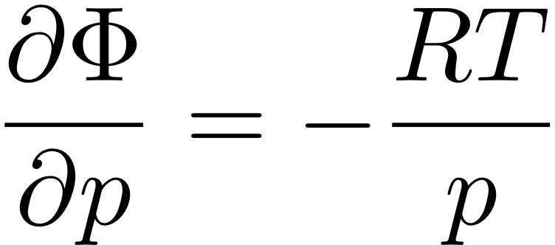
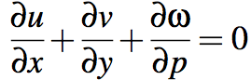
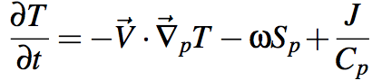
“The Primitive Equations”
(meaning elemental, fundamental)
PGF becomes
-g times slope ∂Ζ/∂x
of p surfaces! →
F=ma in the HORIZONTAL (in p coords)
← dw/dt neglected formally
HYDROSTATIC (w/ ideal gas law to eliminate ρ)
∂ρ/∂t vanishes exactly
sound waves are excluded
MASS CONSERVATION
FIRST LAW OF THERMO
s: dry static
energy
θ: potential
temperature
“static stability
parameter”
S_{p} = (∂s/∂p /C_{p}) = (∂θ/∂p T/θ)
Notes:
\frac{D}{Dt} \vec V_h = -f \hat k \times \vec V_h - \vec \nabla_p \phi +\vec F_r
\frac {\partial \Phi}{\partial p} = - \alpha \equiv -\frac{1}{\rho}
\alpha = \frac{RT}{p}
\frac {\partial u}{\partial x} + \frac {\partial v}{\partial y} + \frac {\partial \omega}{\partial p} = 0
\frac {D_hT}{Dt} + S_p \omega = J/C_p

Slide 18
What can we do with the PDEs II
2. Try to get conservation form
d/dt(stuff) = 0 can be rewritten as:
∂/∂t(stuff) = transport
= advection
upwind values comin’ at ya!
= convergence of flux
integrates to become boundary flux (Gauss)
zero over any unbounded domain (like atm)!
key to global climate ODE: dT/dt = (Rad_{TOA})/C_{p}

Slide 19
Conservation quasi-laws
d/dt(stuff) = 0
What is this conserved stuff?
potential temperature or dry static energy
“diabatic heating/cooling” is its source/sink
→ dry adiabatic lapse rate g/C_{p} for well-mixed (constant s) layer
momentum: not very conserved (has PGF)
relative vorticity: more conserved (PGF gone)
absolute vorticity: mo more conserved (Ro wave)
potential vorticity: most conserved
dQ/dz is the main source:
dynamics driven by vertical derivative of diabatic heating
Curl of friction is the sink

Slide 20
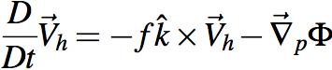
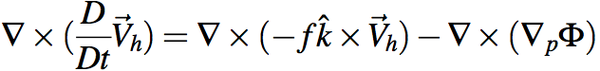
Holy Grail: eliminate RHS terms!
Get rid of Φ term at any cost. Curl to the rescue!
Ker-CHING!
We are Masters of the Universe with our sexy vector identities!
The grail is in the bag!
Notes:
\nabla \times (\frac{D}{Dt} \vec V_h) = \nabla \times (-f \hat k \times \vec V_h) - \nabla \times (\nabla_p \Phi)

Slide 21
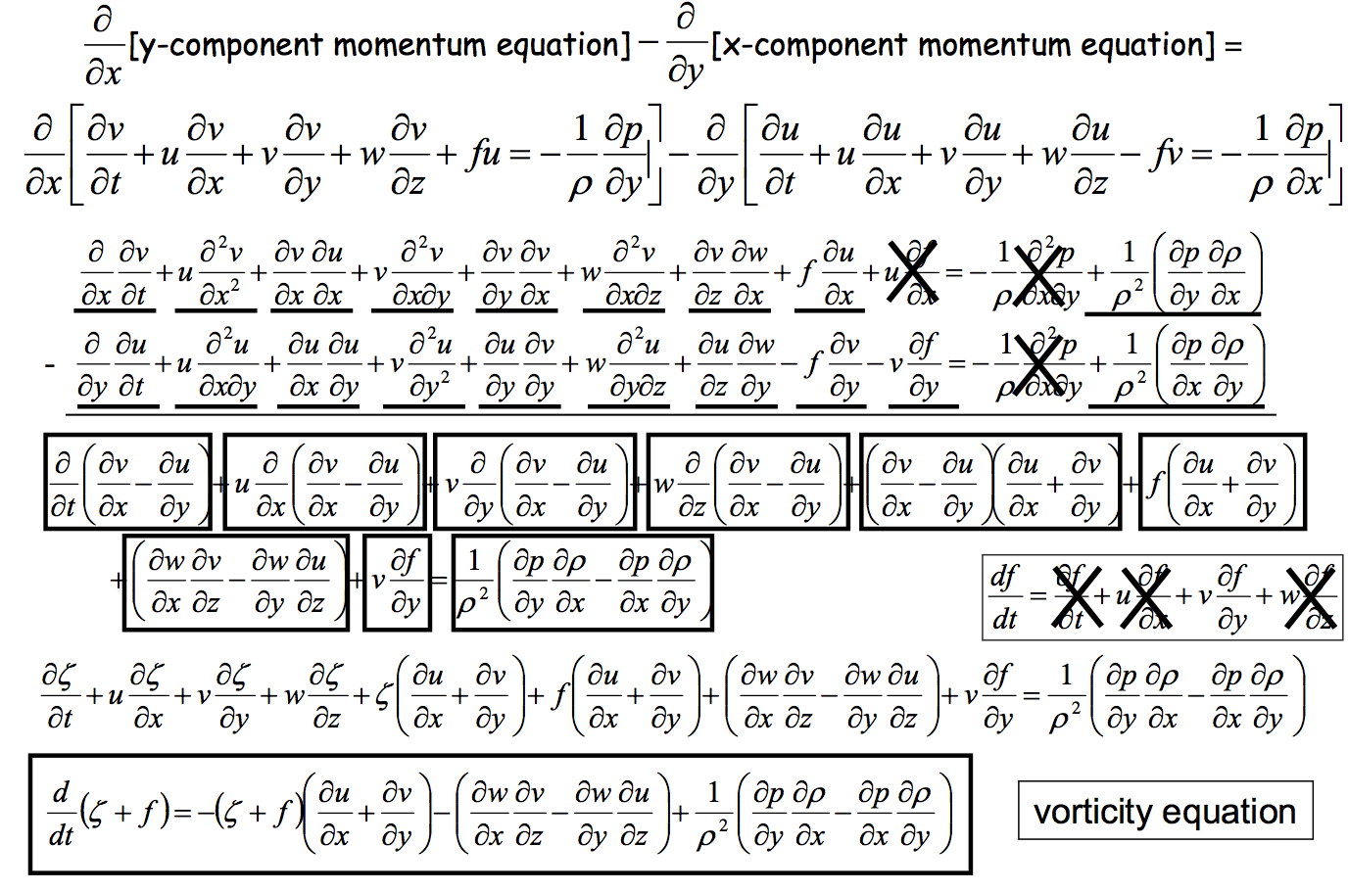
Heh heh ... did I say "any cost"... ? gulp

Slide 22
Vorticity conservation: Relative
d/dt(relative vorticity) = 0 ← 2D “BVE”
vorticity elements “induce” (or imply) tangential flow:
V_{tan} α 1/distance ← DING DING DING
that tangential flow in turn advects vorticity:
2 vorticity elements orbit (if same sign), promenade like a smoke ring (if opposite sign), shred each other, merge, interact as groups, etc. → heart of the horizontal forecast problem, chaos, turbulence, etc.

Slide 23
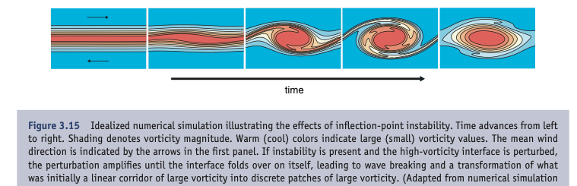
Vorticity instability
A line or filament of vorticity within the interior of a fluid is unstable: waves grow, and then roll up into balls of vorticity. Animation
Markowski and Richardson book 2011

Slide 24
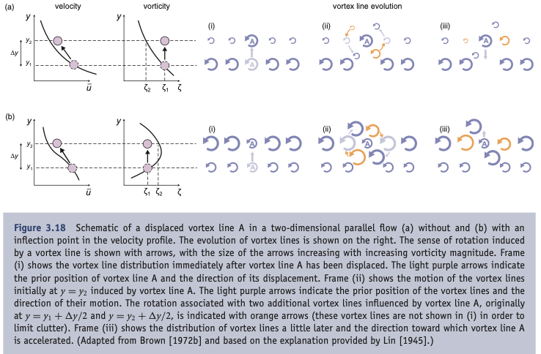
Vorticity instability
A line or filament of vorticity within a fluid is unstable: displacements grow w/ time. How?
Markowski and Richardson book 2011

Slide 25
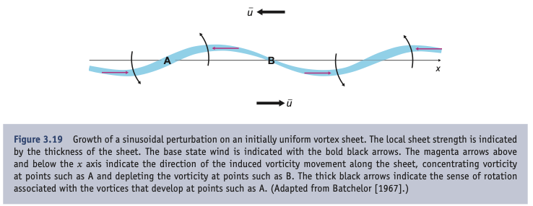
Vorticity instability
Waves roll up into balls. How?
along-filament transport in finite amplitude waves:

Slide 26
Vorticity conservation: Absolute
d/dt(absolute vorticity) = 0
so
d/dt(relative vorticity) = -v ∂f/∂y
→ Rossby waves
westward phase propagation speed
eastward group (energy) “ “
both proportional to wavelength²
Long waves act as Rossby waves
Short waves are just advected vortices
(troughs=lows or ridges=highs)

Slide 27
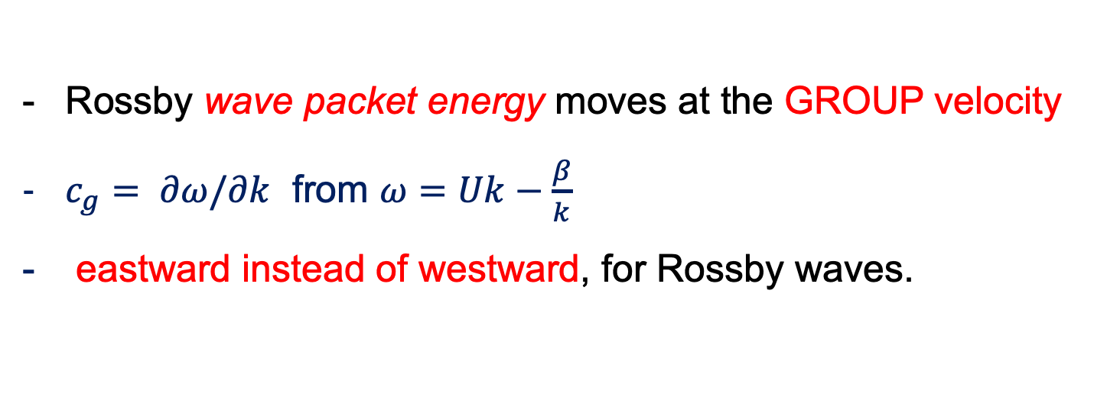
Rossby Waves: phase vs. group velocity
this c is phase velocity
Rossby wave packet energy moves at the GROUP velocity
$c_{g}= ∂ω/∂k$ from $ω=Uk−\frac{β}{k}$
eastward instead of westward, for Rossby waves.
Note!! →
Notes:
2

Slide 28
Rossby wave group velocity energetics (downstream development):
Waves here strengthen
Waves here weaken
Energy flux

Slide 29
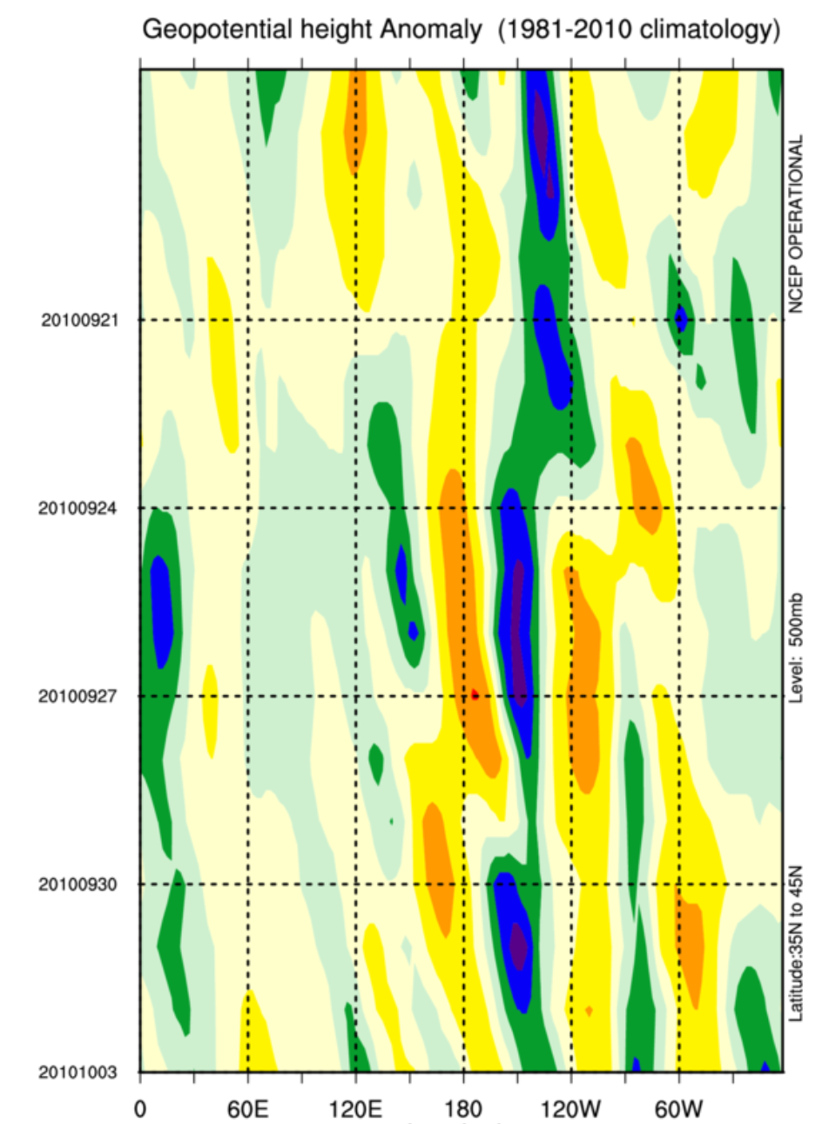
Example:
Z’(lon, time)
diagram
phase velocity near zero (almost stationary waves,) like in the river
time→
group or energy speed: fast eastward

Slide 30
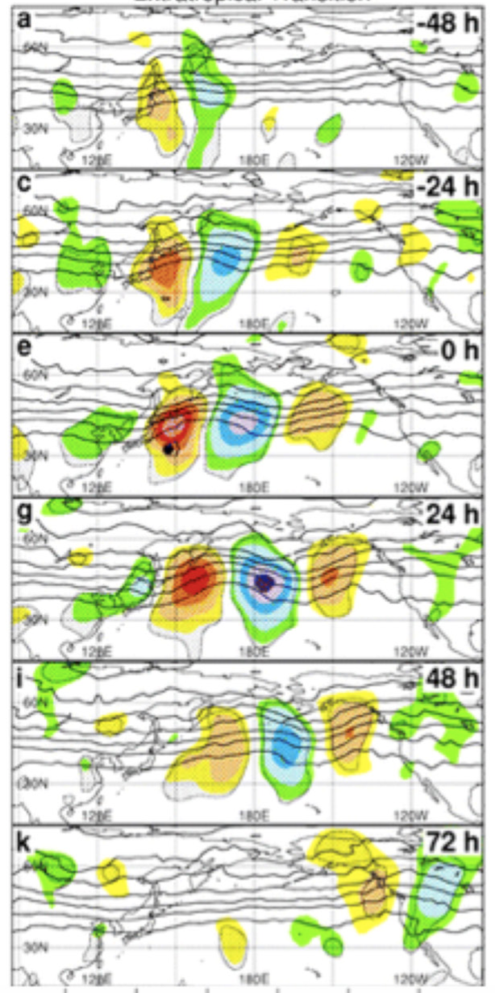
stationary Rossby waves: long waves
advection by U>0 balances westward propagation of phase
important special case because strong forcings are often stationary (like mountains or SST warm pools = convective heat sources)
This is not quite stationary: phase is advected to east→

Slide 31
Conservation quasi-laws
d/dt(potential vorticity) = 0
Phenomena include all of the above, PLUS
conversion of stability ←→ vorticity
mainly when air descends from the stratosphere into upper troposphere, and spins up cool core cyclones abruptly
→ some extra severity to winter storms sometimes

Slide 32
Conservation quasi-laws
d/dt(PV) = κ ∂Q/∂z
Cyclonic PV created at base of latent heating
→ warm core cyclones (hurricanes)
Cyclonic PV created at top of radiative cooling
→ cool core polar vortex (and tentacles)

Slide 33
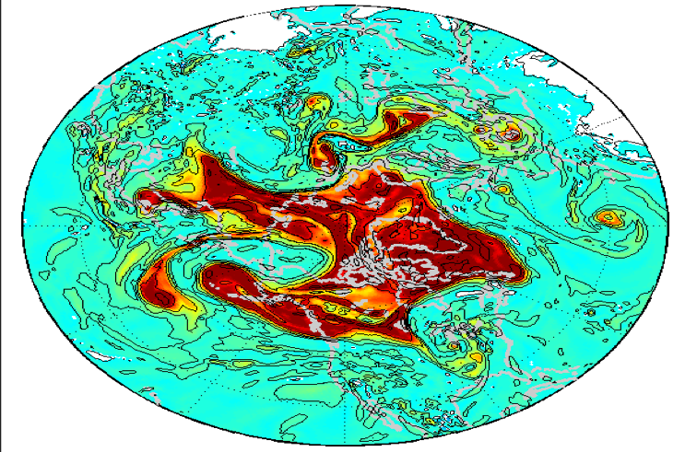
Polar vortex is unstable:
Jet stream develops Rossby waves.
These break
(like surf).
Rossby wave troughs (or cutoff bits of the cold-core polar vortex) are midlat. storms
They make clouds ahead of troughs

Slide 34
The atmosphere moves because of
heating / cooling, damped by Friction
F=MA in the HORIZONTAL
Friction keeps it finite
HYDROSTATIC (w/ ideal gas law to eliminate ρ)
MASS CONSERVATION
FIRST LAW OF THERMO
J makes it go!
Notes:
\frac{D}{Dt} \vec V_h = -f \hat k \times \vec V_h - \vec \nabla_p \phi +\vec F_r
\frac {\partial \Phi}{\partial p} = - \alpha \equiv -\frac{1}{\rho}
\alpha = \frac{RT}{p}
\frac {\partial u}{\partial x} + \frac {\partial v}{\partial y} + \frac {\partial \omega}{\partial p} = 0
\frac {D_hT}{Dt} + S_p \omega = J/C_p

Slide 35
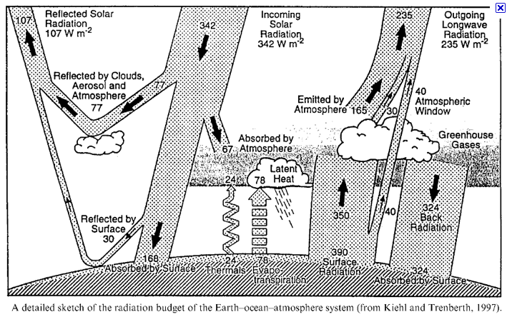
mean J maintains mean state, gradients of J make it go

Slide 36
What can we do with the PDEs III
3. Build complete numerical models
Primitive equation solvers = “dynamical core”
Physical process parameterizations
Treatments for nonfluid processes
latent heat of phase changes of water
microphysics of condensed particles
radiative energy transfer including cloud effects
electrical processes, etc. etc.
Approximations for fluid motions finer than mesh
turbulence in the PBL, surface conduction and friction
cumulus activity (penetrative updrafts and downdrafts, etc. etc.)
internal gravity waves, frictional dissipation of wind KE, etc. etc.

Slide 37
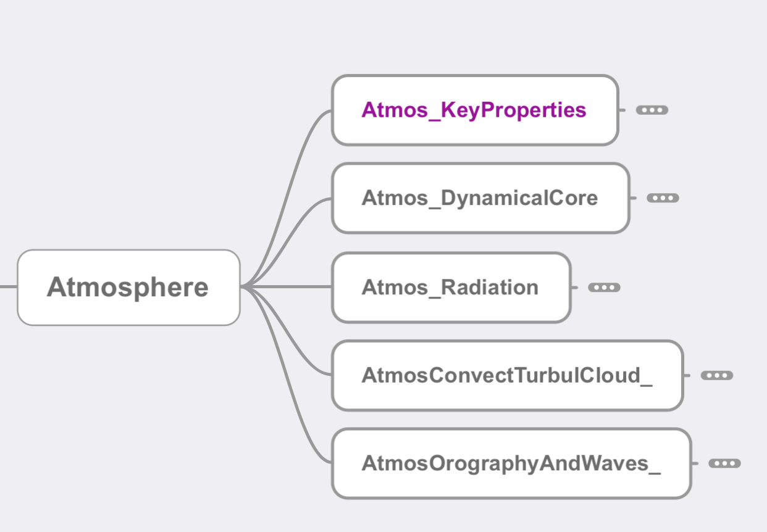
Mind map of atm model

Slide 38
Part II: Logic (combining “grammar” elements)
equation sets
combinations of assumptions
multi-step reasoning
multi-time-step evolution of flow
recalling that the PDEs relate INFINITESIMAL time steps to INSTANTANEOUS spatial gradients!!
INFINITELY TEDIOUS BOOKKEEPING! DON’T LEAP!
Transport illustration: https://github.com/ATMOcanes/ATM651/blob/master/Week1-2_basics/Advection_diffusion.demos.pdf

Slide 39
Thermal wind balance
Combination of TWO force balances
in the horizontal (geostrophic; or gradient)
in the vertical (hydrostatic –> THICKNESS α TEMP.)
the wind shear (or wind difference with height) obeying this balance is called thermal wind
sign and sense of the term:
upperlevel = lowerlevel + thermalwind

Slide 40
p surfaces on a z-coordinate diagram
for NH westerly jet stream in thermal wind balance
→
z
150 mb
thinner mass (Δp) layers,
cooler compared to
← that
big thickness of mass (Δp) layers: warm compared to that →
200 mb
300 mb
Jet stream
into page
PGF is “downhill”
Coriolis force to R
500 mb
small thickness
of mass (Δp) layers:
cooler, compared to that→
mass (Δp) layers
are thicker: warmer than
← that
700 mb
1000 mb
North
South

Slide 41
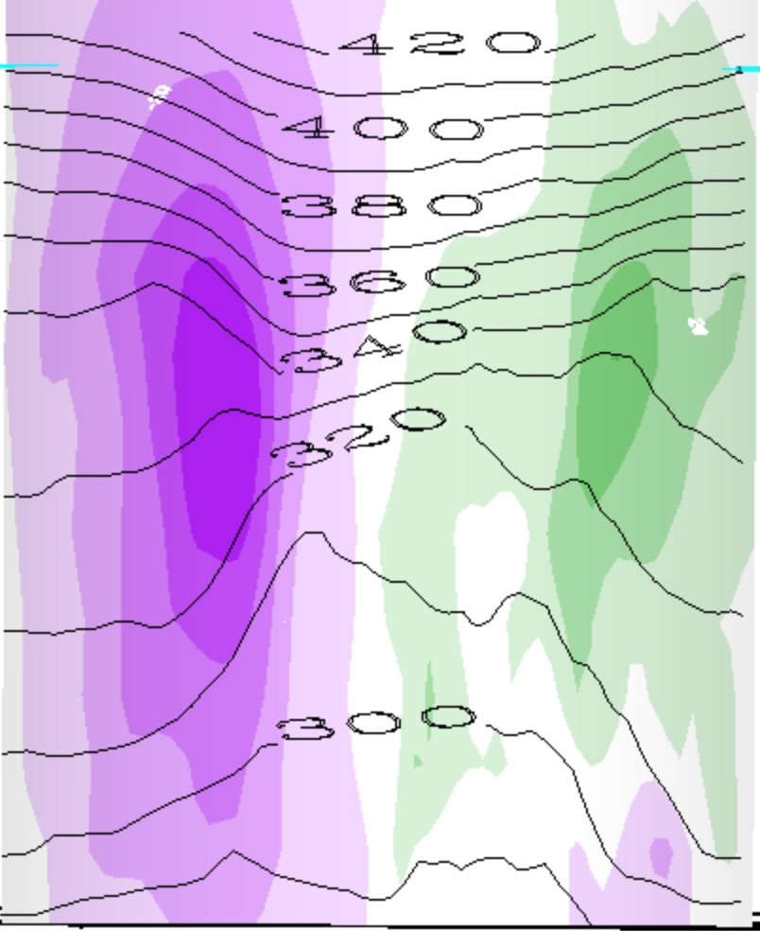
This is a whole vortex (two jets)
θ(K) contours
warmer than
← that →
above the cyclone
cooler than
← that →
below the cyclone

Slide 42
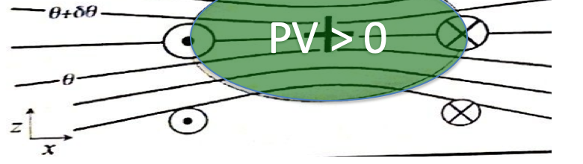
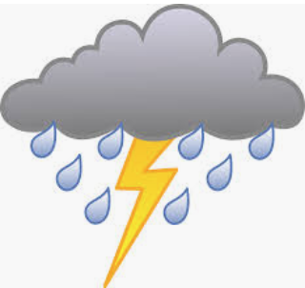

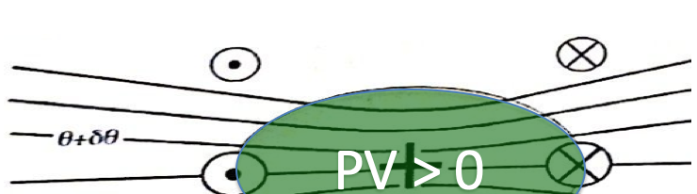
Since our main weather concern is in the lower troposphere (where water is),
This is called a cool core cyclone:
This is called a warm core cyclone:

Slide 43
Another Logic idea: instability
horizontal instability: vorticity rolls up
vertical instability: parcels run away
pattern growth (or positive feedback) in specific situation (midlatitude storm)

Slide 44
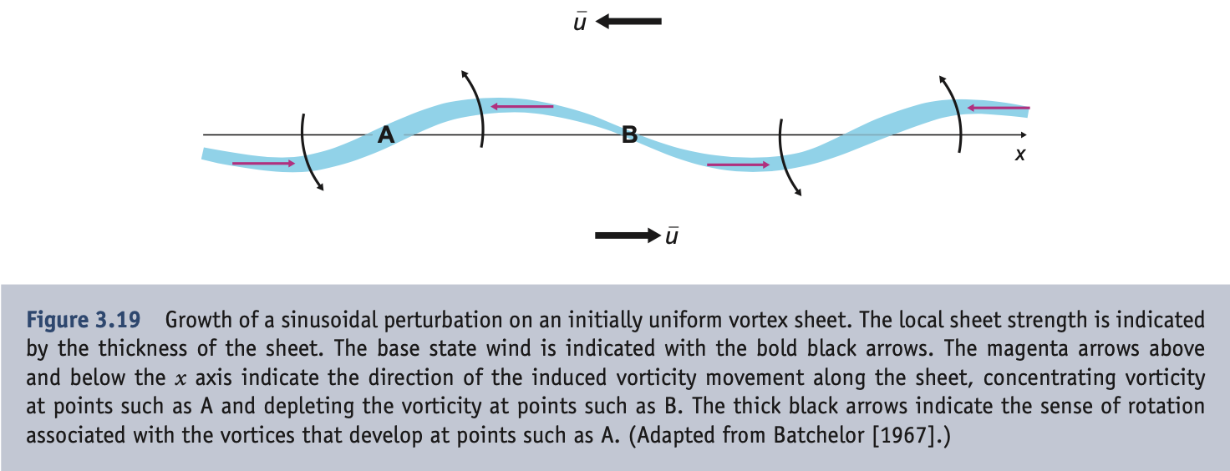
horizontal instability
Filaments of vorticity would rather get wavy
and then they would rather roll up into balls

Slide 45
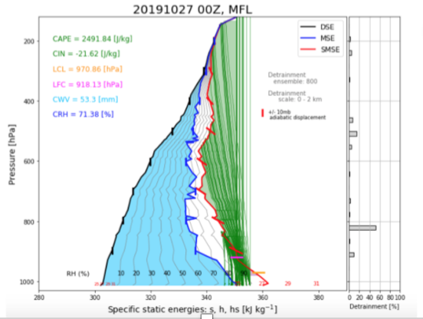
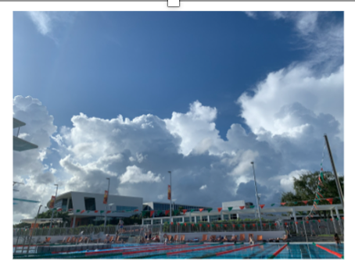
vertical: conditional instability
if a lifted parcel is buoyant, runaway ascent
Moist lifted air can be buoyant if h_{sat}( T(p) ) profile has a minimum in midlevels

Slide 46
how conditional instability couples with synoptic systems
cool core
→ instability → heating
negative feedback
(downward flux of PV:
a cool core cyclone
can drive a warm core cyclone
to develop by moist heating)
sfc. moisture → convection
→ heating
PV at base of heating
cyclone (→frictional inflow)
wind-driven evaporation
more surface moisture
TC pos.
feedback
loop:

Slide 47
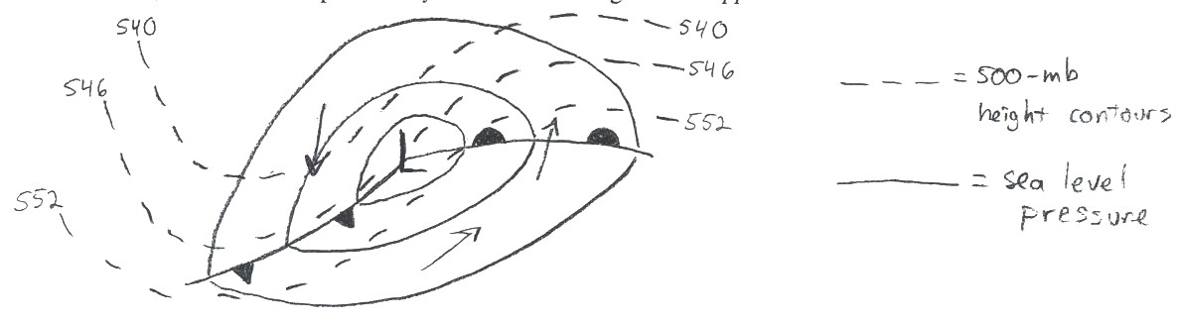
Synoptic instability heuristic:
Adiabatic cyclone “Self Development”
Some midlatitude cyclones exhibit a positive feedback involving temperature advection and upper-level troughs and ridges
upper wave (approaching trough’s vorticity) → upward motion, surface convergence → surface cyclone formation or strengthening
Now, consider impact of lower cyclone on strength of upper wave:

Slide 48
Sutcliffe-Petterssen “Self Development”
540
540
546
546
L
552
A
B
552
advection causes…
…strengthening
Upper trough: stronger
Upper ridge: stronger
Cold advection
Warm advection
L
up
A
B

Slide 49
Logical combining of eq’n terms
Primitive equations written down
But how do the terms light up in the development of relevant systems?
warm core cyclone
cool core cyclone

Slide 50
Heating and cooling driven flows
Sun heats surface (→evap), air cools by IR
troposphere cools 1-2 K/day ~ 150 W m⁻²
Tropos. warmed by latent heat release in rain
~ 150 W m⁻² or 3-4 mm/d of P=E
localized in hot spots → warm core cyclones (TCs)
Poles: no sun, cooold troposphere in winter
→ cold core “polar vortex” at tropopause
Jet stream instability in midlatitudes
tentacles stretch or break off of polar vortex
→ cool core synoptic cyclones
(upper troughs, sfc lows)

Slide 51
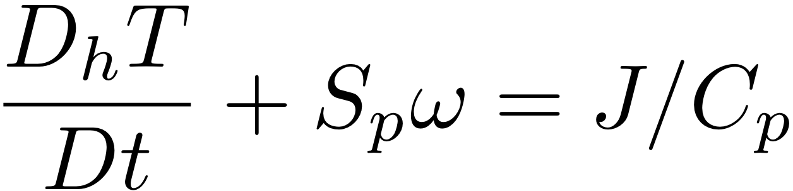
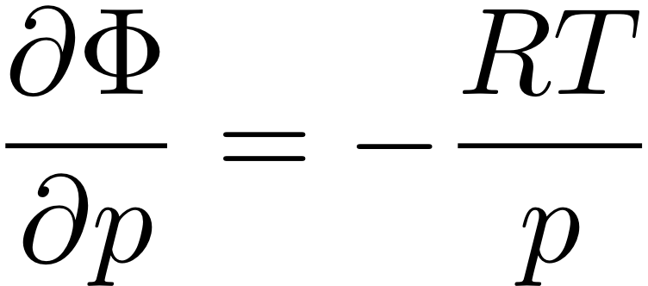
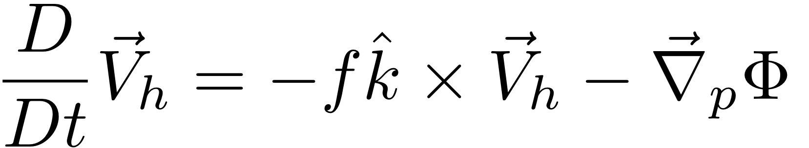
HW: use The Primitive Equations to compute how a local heating J drives flow in an initially motionless atmosphere
J causes T to increase
net change of T =
amount of heat added/Cp
2. Warmer T causes increased thickness of the heated column
3. High Φ over hot column pushes wind outward
4. Surface pressure drops (remember, omega = Dp/Dt; Holton eq. 3.44)
Notes:
Homework 5, MSC 405. Due Thursday, April 13
This problem set walks through the heated-air-rising process above, for a 100 km patch of latent heating in an initially motionless atmosphere.
ALL ANSWERS MUST HAVE UNITS, BUT NUMBERS CAN BE SIMPLE ROUGH ESTIMATES.
Suppose the heating J corresponds to the latent heat released during 1cm of rain over a 100km x 100km area. Let’s figure out how much ΔT that causes.
What is the volume of water condensed (m³)?
What is the mass of water condensed (kg)?
How much latent heat is released (Joules)? (L = 2.5 x 10⁶ J per kg of water).
How many kg of air are in a 1 square meter column of atmosphere, if surface pressure p is 1000mb? M=p/g
How many kg of air are therefore in a 100km x 100km column?
If Cp = 1000 J/(kg K), by how many K can the heat from c. warm the air mass from e.?

Slide 52
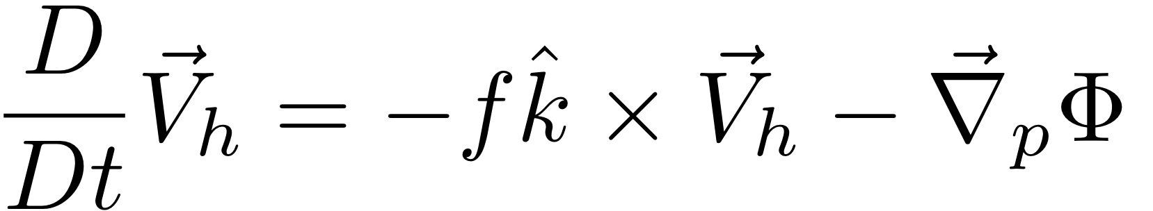
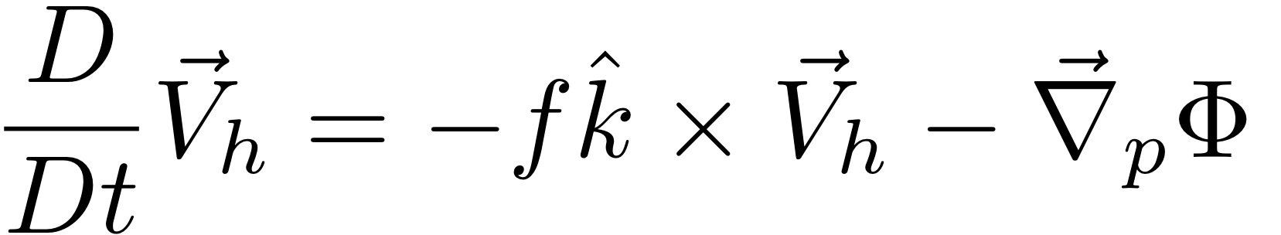
HW: use The Primitive Equations to compute how a local heating J drives flow in an initially motionless atmosphere
5. Low Φ under hot column pulls wind inward
6. Hot air rises (finally!)
ω =~ ρgw
7. Coriolis force turns inflowing and outflowing air to make round-and-round flow
Notes:
Homework 5, MSC 405. Due Thursday, April 12
This problem set walks through the sequential process above, for a 100 km patch of latent heating in an initially motionless atmosphere.
ALL ANSWERS MUST HAVE UNITS, BUT NUMBERS SHOULD BE ROUGH: 1-2 SIGNIFICANT DIGITS.
Suppose the heating J corresponds to the latent heat released during 1cm of rain over a 100km x 100km area. Let’s figure out how much ΔT that causes.
What is the volume of water condensed (m³)? (1 point)
What is the mass of water condensed (kg)? (1 point)
How much latent heat is released (Joules)? (1pt) (L = 2.5 x 10⁶ J per kg of water).
How many kg of air are in a 1 square meter column of atmosphere, if surface pressure p is 1000mb? M=p/g (1)
How many kg of air are therefore in a 100km x 100km column? (1)
If Cp = 1000 J/(kg K), by how many K can the heat from c. warm the air mass from e.? (1)

Slide 53
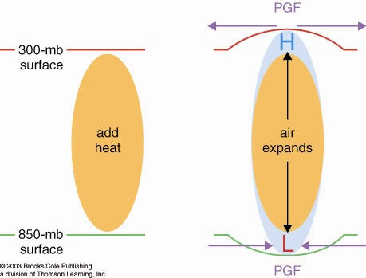
How heated air rises and a warm core vortex develops: the Primitive Equation view. 7 logical steps
1. Warmed column of air gets thicker
2. Air accelerates
due to PGF
2. Air accelerates
due to PGF
1. 200 mb
surface
bulges
upward
0. Heating (maybe latent heating by condensation in a patch
of convection over warm water someplace)

Slide 54
How heated air rises and a warm core vortex develops: the Primitive Equation view. 7 logical steps
3. Mass removal and 4. surface pressure drop
3. Mass removed
from column
3. Mass removed
from column
*dx*dy*dzstar
4. less mass of air in column
= lower surface pressure
L

Slide 55
How heated air rises and a warm core vortex develops: the Primitive Equation view. 7 logical steps
5. Low level inflow accelerates, 6. heated air rises
6. warm
air
rises!
(continuity)
5. Air accelerates
due to PGF
5. Air accelerates
due to PGF

Slide 56
How heated air rises and a warm core vortex develops: the Primitive Equation view. 7 logical steps
ANTI
CYCLONIC
Warm Core
Vortex
in thermal wind
balance
CYCLONIC
FLOW
7. Coriolis turns flow to right

Slide 57
Heating and cooling driven flows
Sun heats surface, atmos. cools by IR
troposphere cools 1-2 K/day ~ 150 W m⁻²
Tropics warmed by latent heat release in rain
also ~ 150 W m⁻² or 3-4 mm/d of P=E
localized → warm core vortices (TCs)
Poles: no sun, cooold troposphere in winter
→ cold core “polar vortex” at tropopause
Jet stream instability in midlatitudes
tentacles stretch or break off of polar vortex
→ cool core synoptic cyclones (troughs, lows)

Slide 58
HW: use The Primitive Equations to compute how a local heating J drives flow in an initially motionless atmosphere
J causes T to decrease
net change of T =
amount of heat added/Cp
2. Warmer T causes decreased thickness of the cooled column
3. High Φ over cool column pulls wind inward
4. Surface pressure rises (remember, omega = Dp/Dt; Holton eq. 3.44)
Notes:
Homework 5, MSC 405. Due Thursday, April 13
This problem set walks through the heated-air-rising process above, for a 100 km patch of latent heating in an initially motionless atmosphere.
ALL ANSWERS MUST HAVE UNITS, BUT NUMBERS CAN BE SIMPLE ROUGH ESTIMATES.
Suppose the heating J corresponds to the latent heat released during 1cm of rain over a 100km x 100km area. Let’s figure out how much ΔT that causes.
What is the volume of water condensed (m³)?
What is the mass of water condensed (kg)?
How much latent heat is released (Joules)? (L = 2.5 x 10⁶ J per kg of water).
How many kg of air are in a 1 square meter column of atmosphere, if surface pressure p is 1000mb? M=p/g
How many kg of air are therefore in a 100km x 100km column?
If Cp = 1000 J/(kg K), by how many K can the heat from c. warm the air mass from e.?

Slide 59
HW: use The Primitive Equations to compute how a local heating J drives flow in an initially motionless atmosphere
5. High Φ under cool column pushes wind out
6. Cool air sinks (finally!)
ω =~ ρgw
7. Coriolis force turns inflowing and outflowing air to make round-and-round flow
Notes:
Homework 5, MSC 405. Due Thursday, April 12
This problem set walks through the sequential process above, for a 100 km patch of latent heating in an initially motionless atmosphere.
ALL ANSWERS MUST HAVE UNITS, BUT NUMBERS SHOULD BE ROUGH: 1-2 SIGNIFICANT DIGITS.
Suppose the heating J corresponds to the latent heat released during 1cm of rain over a 100km x 100km area. Let’s figure out how much ΔT that causes.
What is the volume of water condensed (m³)? (1 point)
What is the mass of water condensed (kg)? (1 point)
How much latent heat is released (Joules)? (1pt) (L = 2.5 x 10⁶ J per kg of water).
How many kg of air are in a 1 square meter column of atmosphere, if surface pressure p is 1000mb? M=p/g (1)
How many kg of air are therefore in a 100km x 100km column? (1)
If Cp = 1000 J/(kg K), by how many K can the heat from c. warm the air mass from e.? (1)

Slide 60
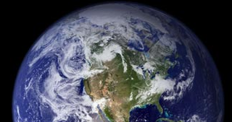
How cooled air sinks and a cool core vortex develops:
the Primitive Equation view. 7 logical steps
1. Cooled column of air gets thinner
2. Air accelerates
due to PGF
2. Air accelerates
due to PGF
200 mb
surface
IR cooling
cold
air
1. 200 mb
surface
bulges
downward

Slide 61
How cooled air sinks and a cool core vortex develops:
the Primitive Equation view. 7 logical steps
3. Mass drawn in
to column
3. Mass drawn in
to column
L
4. more mass of air in column
= higher surface pressure
H

Slide 62
How cooled air sinks and a cool core vortex develops:
the Primitive Equation view. 7 logical steps
L
6. Cold air sinks
5. Air accelerates
due to PGF
5. Air accelerates
due to PGF
H

Slide 63
How cooled air sinks and a cool core vortex develops:
7. Coriolis force turns the winds
L
CYCLONIC
FLOW
Cool
core
Vortex
ANTI
H
CYCLONIC

Slide 64
The geostrophically balanced polar vortex:
The Coriolis force on the westerly jet stream
prevents cold pool of Arctic air from sinking down
and covering the whole Northern Hemisphere
L
Cor.
PGF
PGF
Cor
Heavy cold air
would like to sink
if it could
H

Slide 65
Polar vortex is unstable:
Jet stream develops Rossby waves.
These break
(like surf).
Rossby wave troughs (or cutoff bits of the cold-core polar vortex) are midlat. storms
They make clouds

Slide 67
Part III: Rhetoric
Logic was the combination of Grammar elements (basic ideas and terms).
Rhetoric is the further stringing together of such logical sets of firm principles for a strategic purpose: a narrative, a storyline

Slide 68
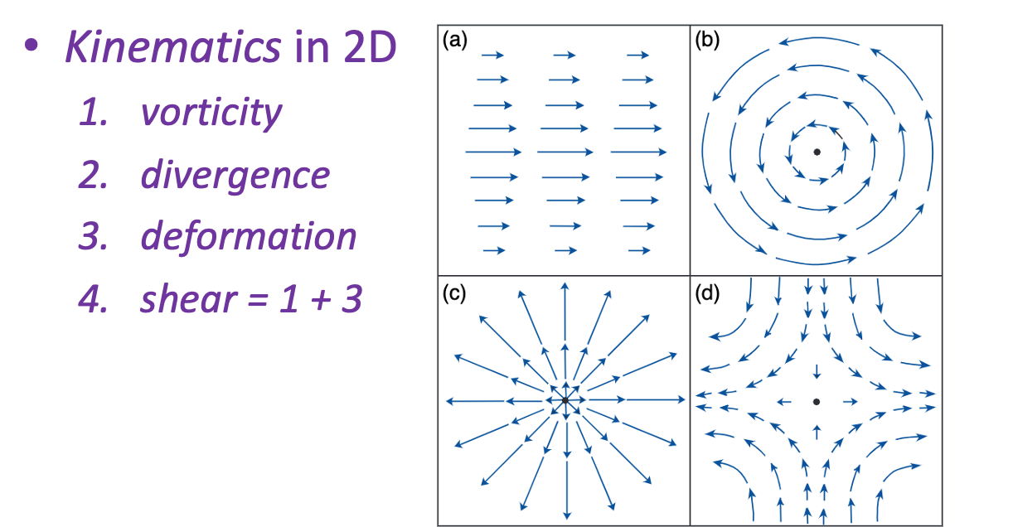
Dividing the flow into parts
We saw that whole vector fields can be decomposed.

Slide 69
Other decompositions
Rotational plus divergent flows
Large-scale plus small-scale
Climate (time mean) plus variable weather
Forced change plus free natural variability
(forced and free solutions to diff. eqs.)

Slide 70
Dividing the flow into parts
Primary plus Secondary: why?
Maybe secondary will be smaller in magnitude
linearizable, dynamics becomes tractable (Ro waves)
Maybe secondary will be smaller in scale
maybe we only want its stats, like a turbulent eddy flux
Maybe secondary is especially important
“engine” driving the energy stored in balanced “flywheel”
or maintainer of the balance approximation’s validity
or maker of weather (saturation, clouds, precip)
ageostrophic is all of these

Slide 71
Dividing the flow into parts
Primary plus Secondary: examples
Time mean (climatology) plus anomaly
Spatial mean (e.g. jet streams) plus eddies
Balanced (e.g. geostrophic) plus imbalanced
Geostophy may be a good enough approximation to the advecting flow, or to the advected momentum, or both (QG)
These are all merely definitions, more clearly written as:
residual = total - approximation
Is it useful? Only if the approximation is meaningful and you intend something strategic!
Keep your eyes on the concept, not just the algebra in these

Slide 72
PhDs: more dynamics (Gen Circ, GFD II) lies ahead; did 651 ready you?
Comps: focus on the essentials, but on UNDERSTANDING them, OWNING the rhetoric level
A knowledge pro knows what they don’t know
so that you can move that line reliably over time
That is precisely what Comps (orals) is designed to test for!
Don’t cram formulas, introspect on what knowledge you have made YOUR OWN – rooted in pure definitions plus logic, the mind we all share, and where the frontier of that lies.
If you are thoughtful and articulate about that frontier, you are ready to be a researcher (PhD Pass).

Slide 73
Others: the end of your dynamics? did 651 orient you?
Transport is tedious bookkeeping at an instant
But one mustn’t leap ahead across time
misconceptions abound
many involve pressure
hydrostatic is fine – but it kills causal reasoning
Phenomena are many and interesting
You know where to find more info now… and the lingo to parse it… warm wishes and thanks for signing up! Keep in touch if you like

